Slide 1





Faculty-Prof. V B Nikam
Canteen Management System.
Our Team-
Name-Abhi Mehta
Reg. No.-221080001
Year-2022-2026.
Subject-DBMS
Name-Aayush Khirraiyya
Reg. No.-221080001
Year-2022-2026.
Subject-DBMS

Slide 2
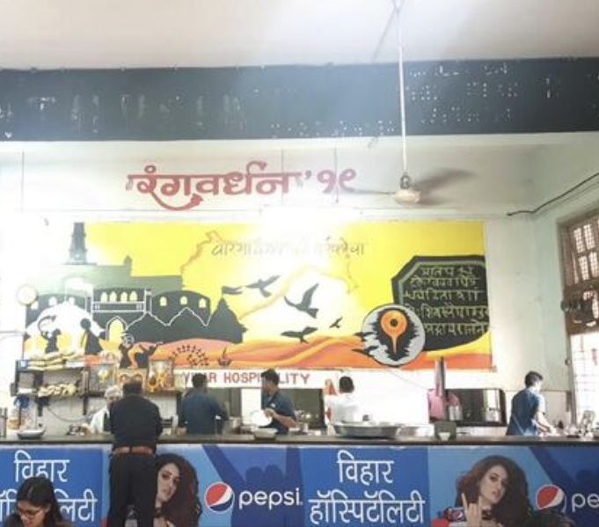
Canteen Management System.
The project is to create a database system for managing a canteen's operations, including menu items, orders, billing, staff management, and user information. It allows tracking orders, managing inventory, handling payments, and monitoring staff activities under the supervision of administrators.
Why this database system : This database system is crafted to streamline and automate the management of various facets within a canteen, providing numerous advantages:
Efficient Order Management: The system efficiently organizes customer orders, including details like items ordered and quantities, facilitating seamless order processing.
Billing and Payment Handling: It automates billing processes, generating bills for orders and recording payment details, thereby simplifying transactions for customers and staff alike.
User Management: The system stores user information, allowing for personalized services and effortless tracking of customer preferences and contact details.
Staff Management: It facilitates order assignment to staff members, monitors their activities, and empowers administrators to manage staff roles and responsibilities efficiently.
Data Analysis: With structured data stored in the database, administrators can conduct insightful data analysis, gaining valuable insights into sales trends, popular menu items, and customer preferences, which can inform strategic business decisions.
Scalability and Adaptability: The modular design of the database schema enables scalability, making it effortless to expand and adapt the system to meet evolving business requirements or accommodate growth in the canteen's operations.Overall, this database system significantly enhances efficiency, accuracy, and decision-making capabilities within the canteen, ultimately leading to enhanced customer service and operational effectiveness.

Slide 3

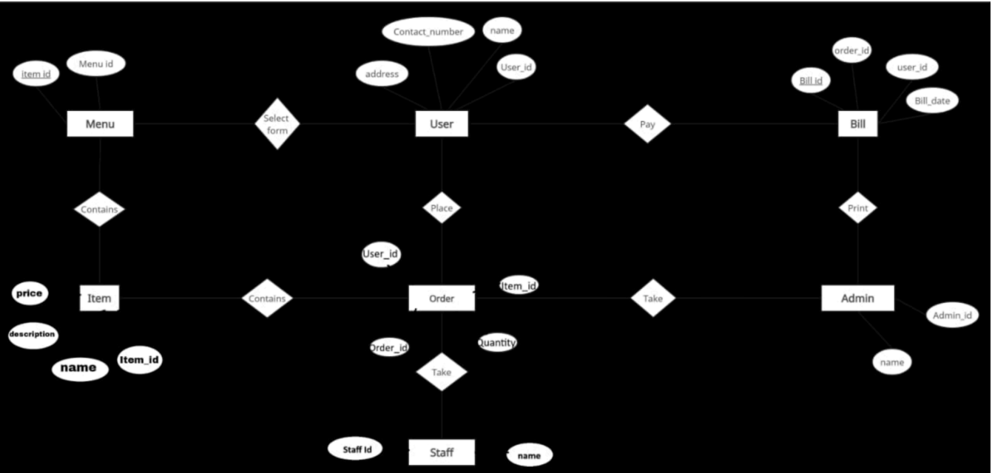

Data Model-

Slide 4


Attributes, Entity and Relations :
- Menu:
● Menu_id (Primary Key)
● Item_id (Foreign Key referencing Item)
- User:
● User_id (Primary Key)
● Name
● Contact_number
● Address
- Bill:
● Bill_id (Primary Key)
● Amount
● Date
● Payment_method
● User_id (Foreign Key referencing User)
- Item:
● Item_id (Primary Key)
● Item_name
● Contents
● Price
- Order:
● Order_id (Primary Key)
● Item_id (Foreign Key referencing Item)
● Quantity
● User_id (Foreign Key referencing User)
- Admin:
● Admin_id (Primary Key)
● Name
- Staff:
● Staff_id (Primary Key)
● Name
-
Relationships:
For the canteen management system, we can define the following relationships:
- User-Order Relationship:
● One user can place multiple orders.
● Each order is associated with one user.
● One-to-Many Relationship.
- User-Bill Relationship:
● One user can have multiple bills.
● Each bill is associated with one user.
● One-to-Many Relationship.
- Item-Order Relationship:
● One item can be included in multiple orders.
● Each order includes multiple items.
● Many-to-Many Relationship.
- Staff-Order Relationship:
● One staff member can handle multiple orders.
● Each order is handled by one staff member.
● One-to-Many Relationship.
- Admin-Staff Relationship:
● One admin can manage multiple staff members.
● Each staff member is managed by one admin.
● One-to-Many Relationship.
- Admin-Item Relationship:
● One admin can manage the items available in the canteen.
● Each item is managed by one admin.
● One-to-Many Relationship.
- Menu-Item Relationship:
● One menu can have multiple items.
● Each item belongs to one menu.
● One-to-Many Relationship.
- Bill-Order Relationship:
● One bill can contain multiple orders.
● Each order is associated with one bill.
● One-to-Many Relationship.
- User-Order Relationship:
● One user can place multiple orders.
● Each order is associated with one user.
● One-to-Many Relationship.
- Staff-Item Relationship:
● One staff member can manage multiple items.
● Each item can be managed by one staff member.
● One-to-Many Relationship.

Slide 5
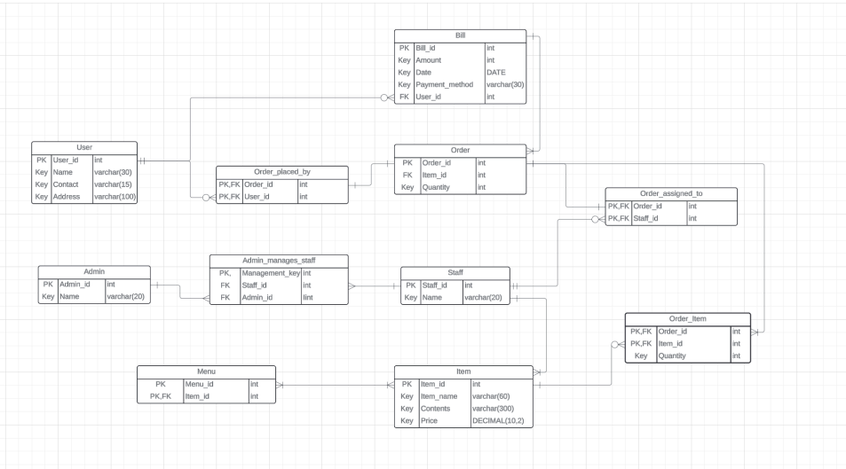
Database Design:-

Slide 6
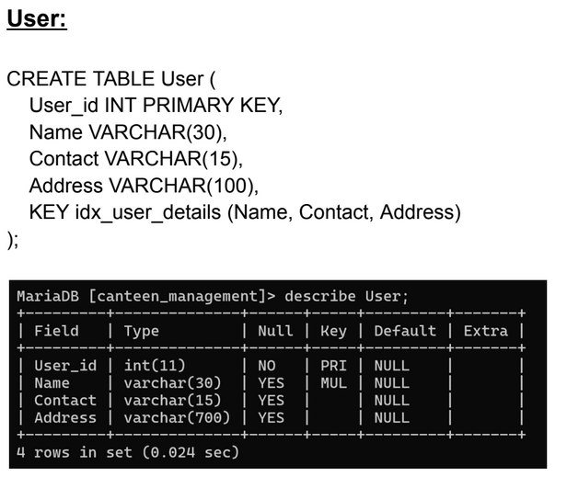
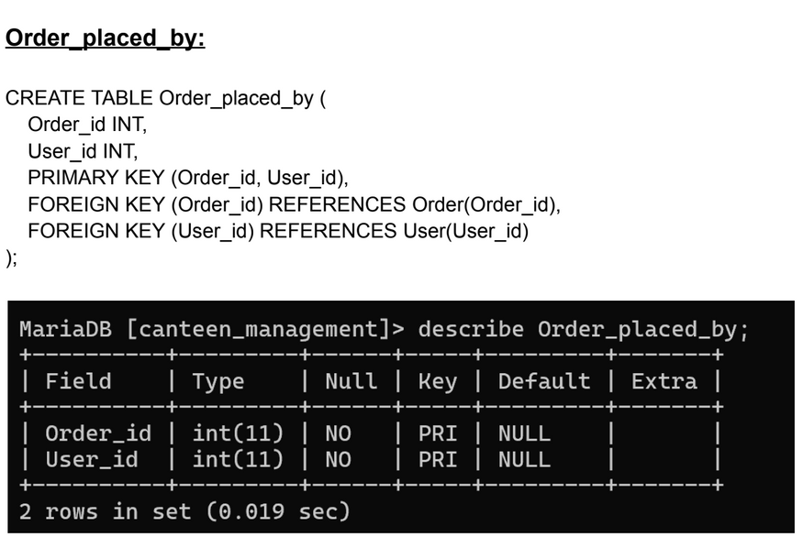
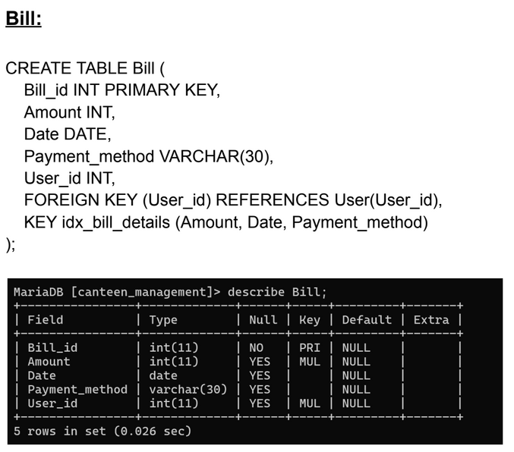
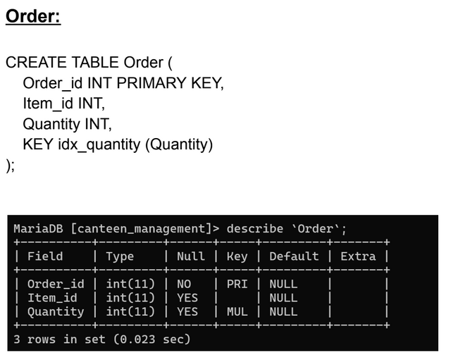
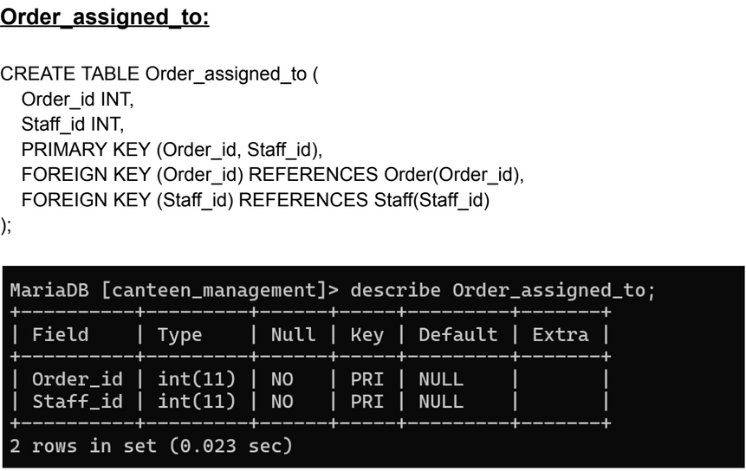
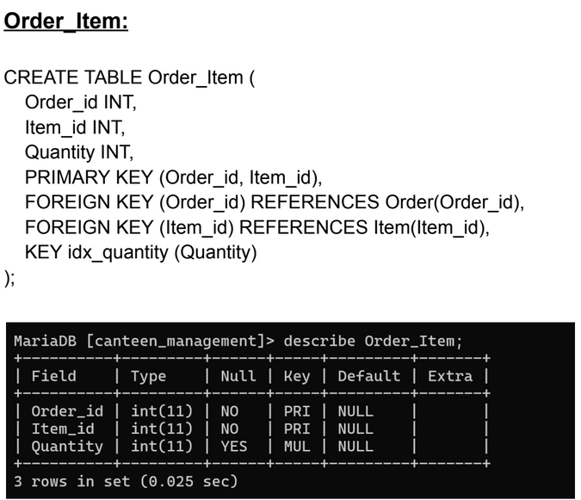
Database Design:-

Slide 7
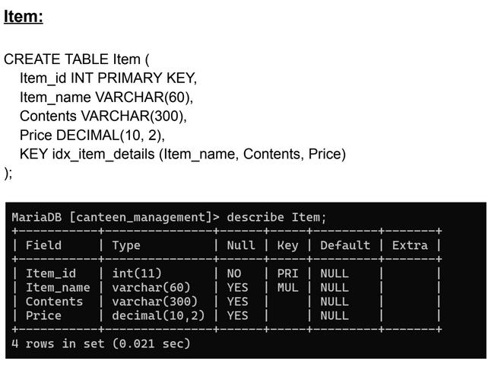
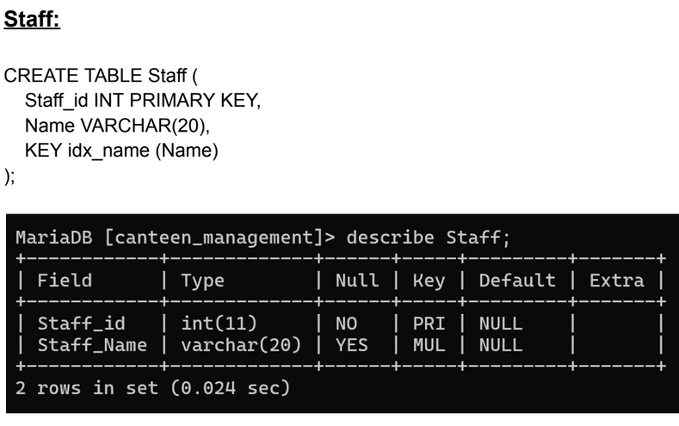
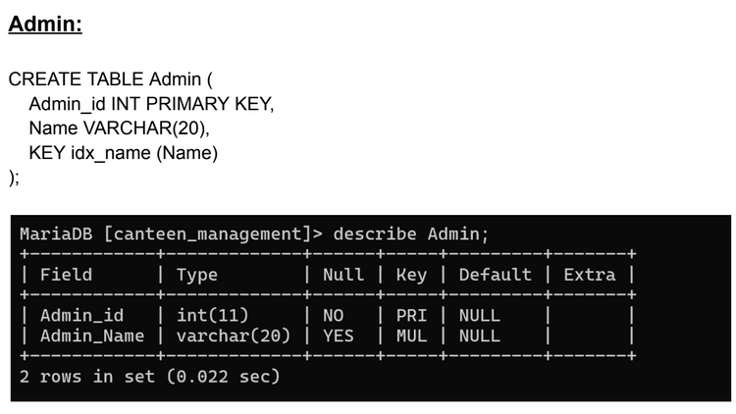
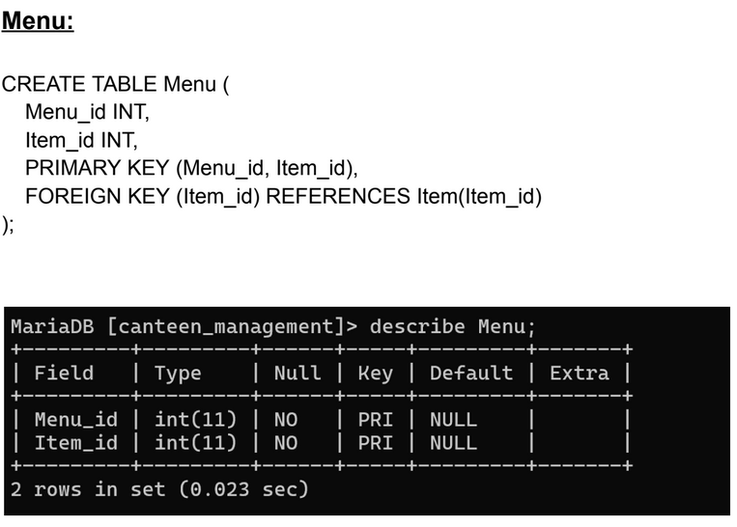
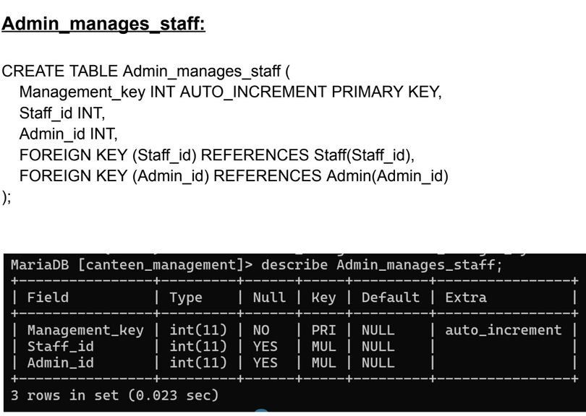

Slide 8
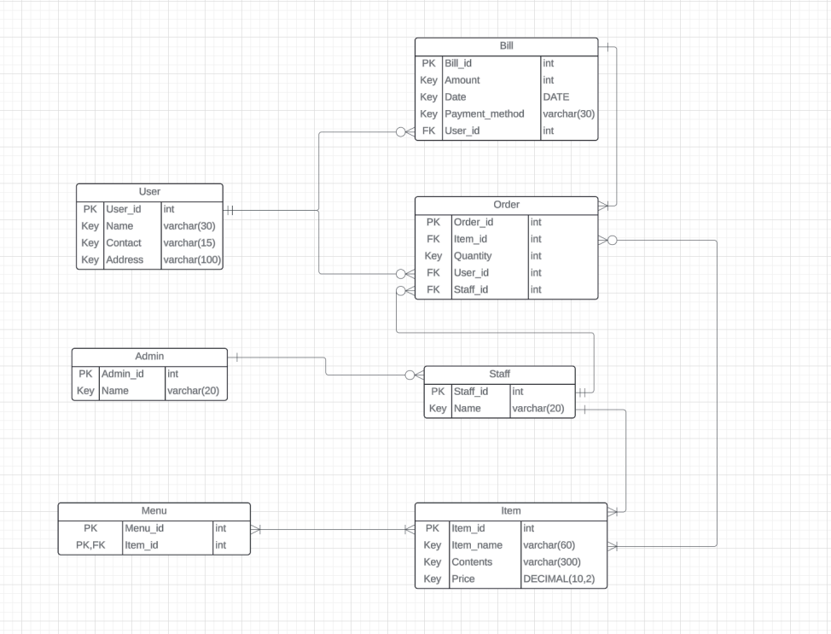
Normalisation to 3NF/BCNF:
1st Step:

Slide 9
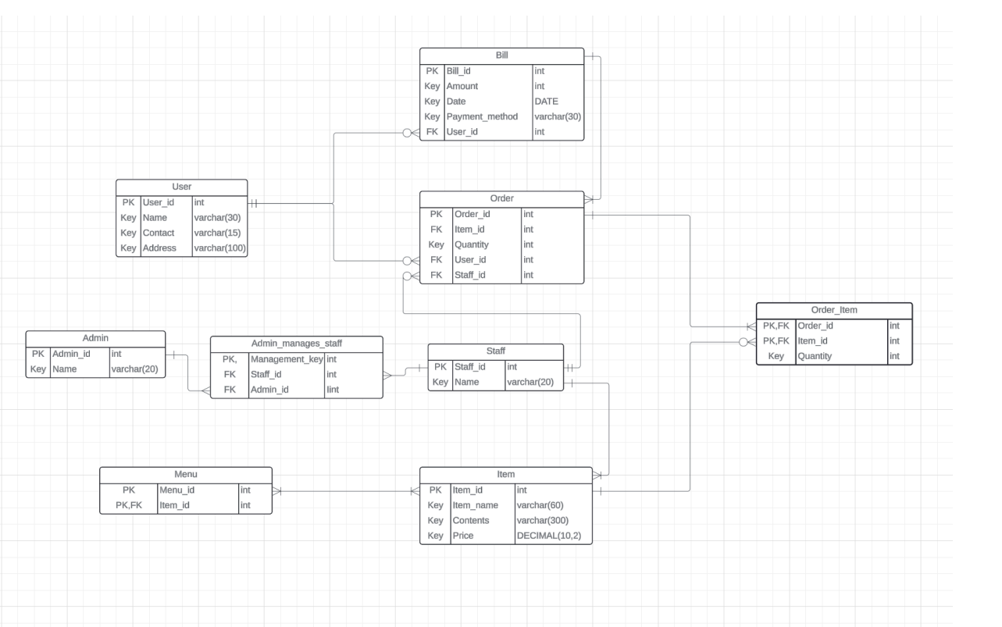

2nd Step:

Slide 10
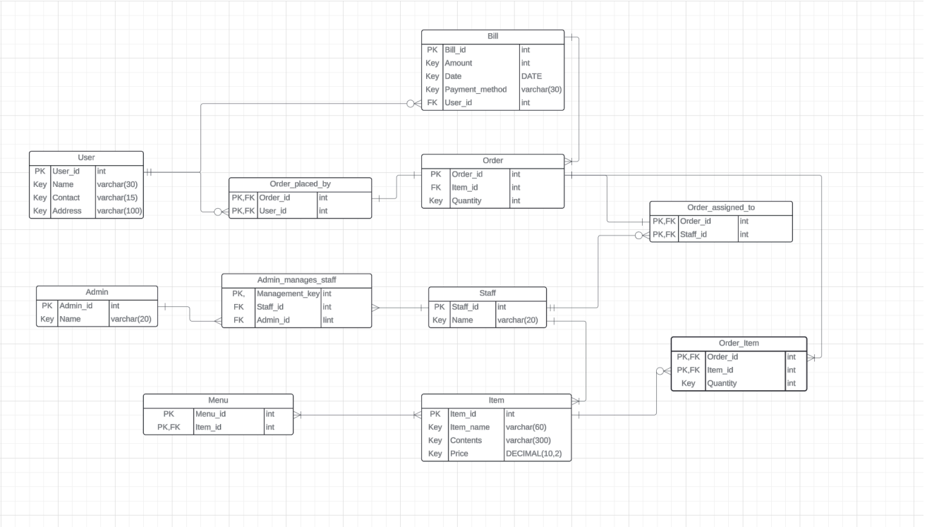
Final 3NF/BCNF Schema:

Slide 11
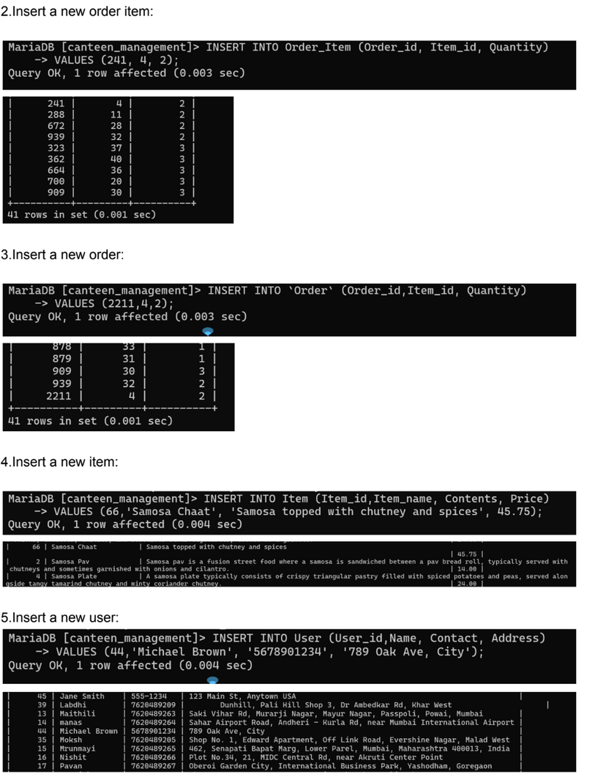
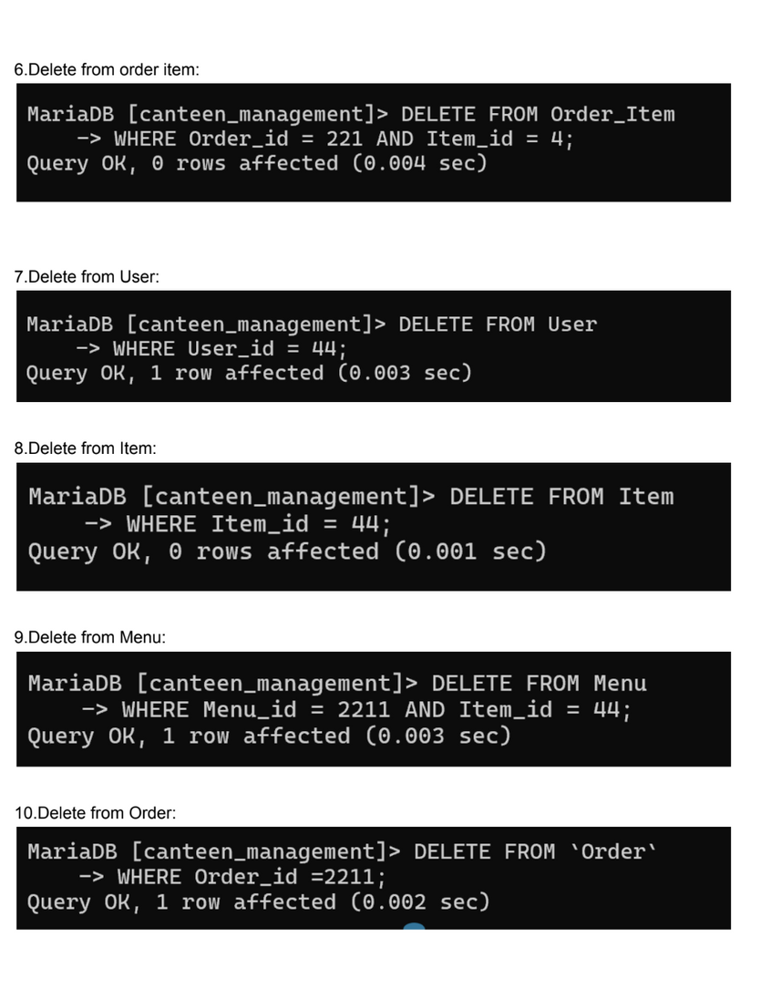
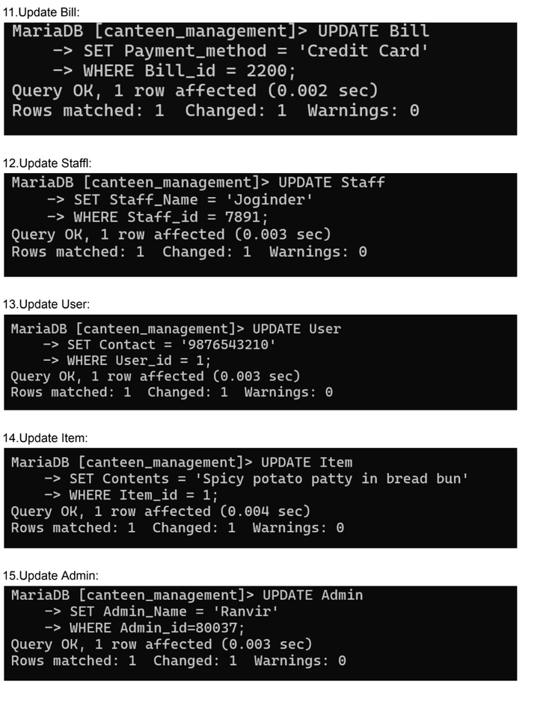
Data Queries:
Insert,Update,Delete:

Slide 12
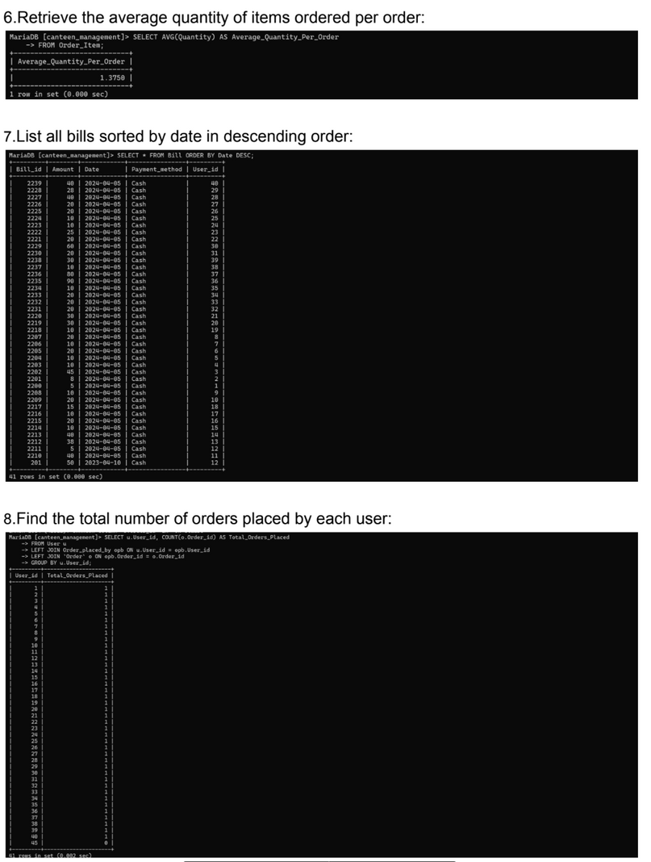
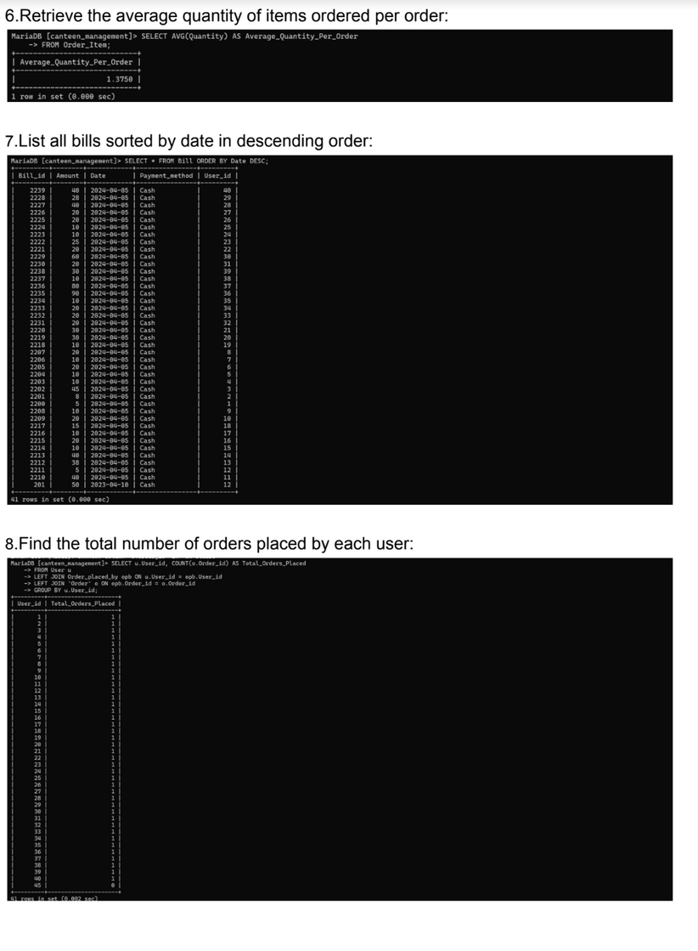
Aggregate Functions:

Slide 13
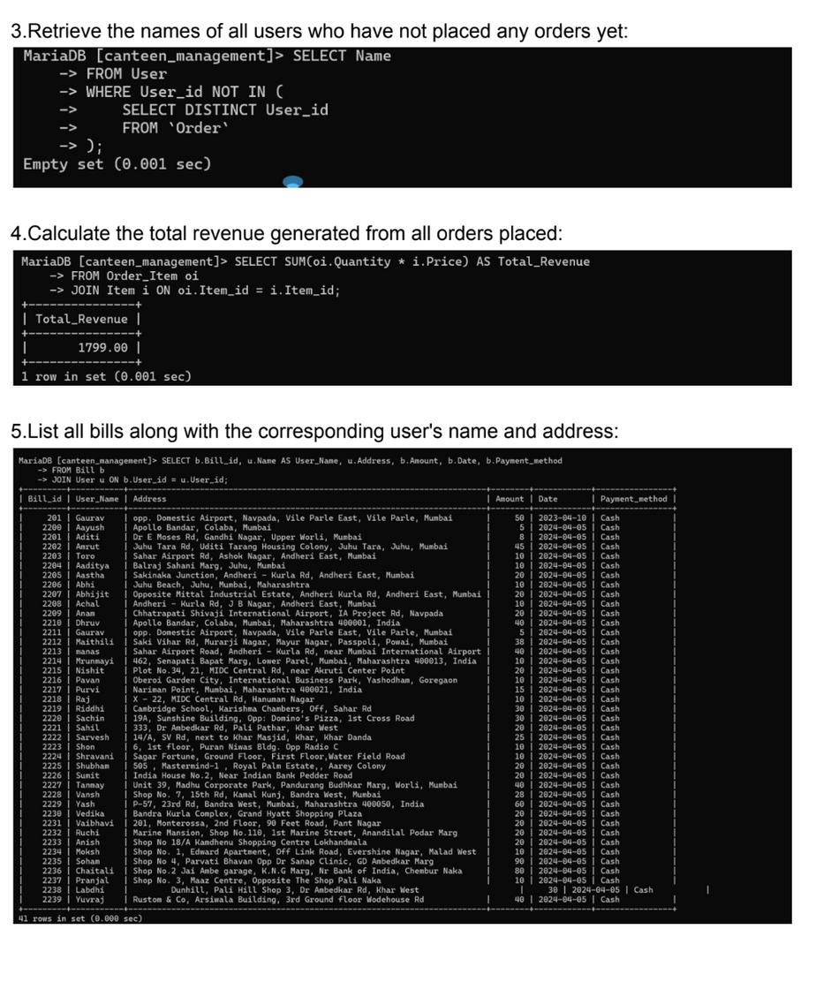
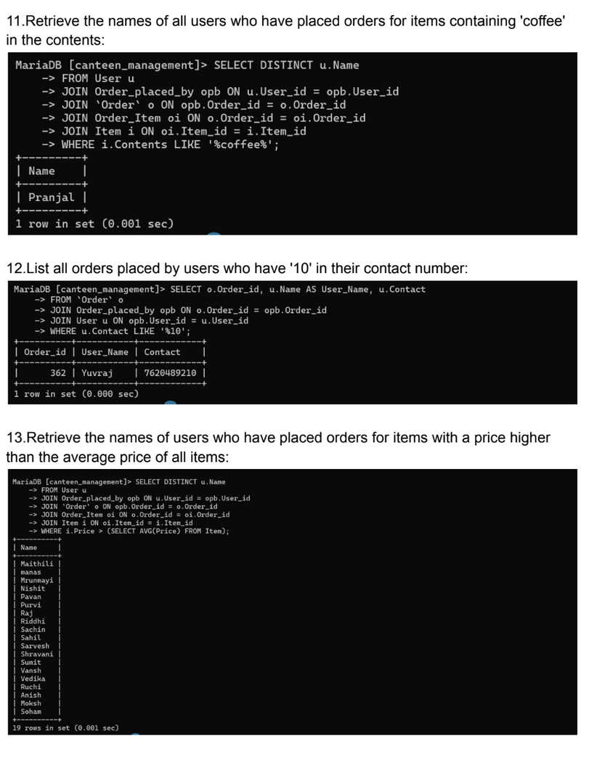
Nested Queries/Join Queries:

Slide 14

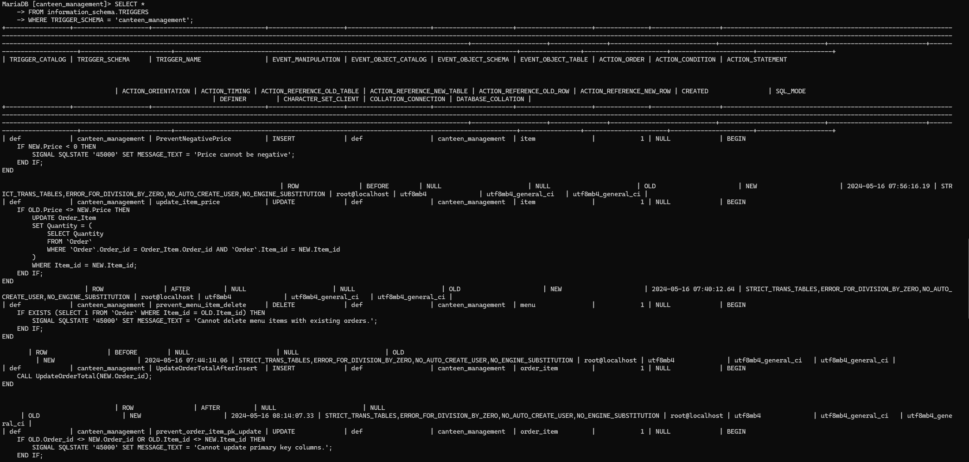

Triggers:

Slide 15
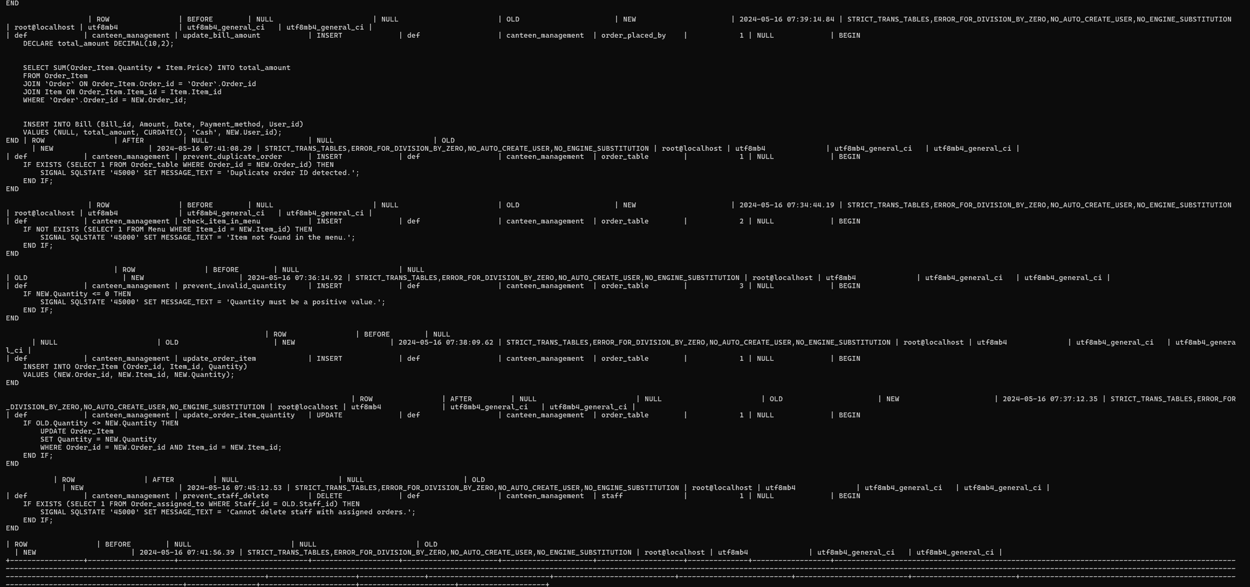
Triggers :

Slide 16
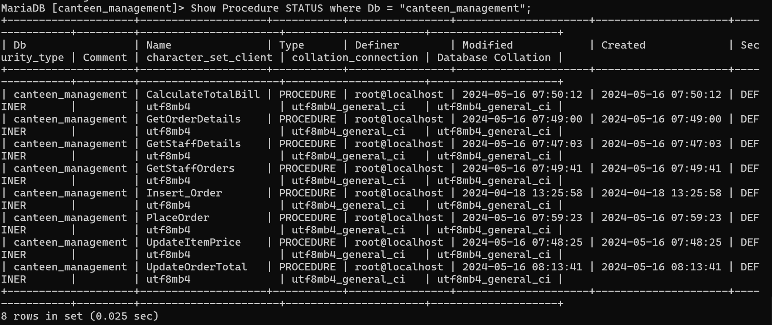
Procedures:-

Slide 17
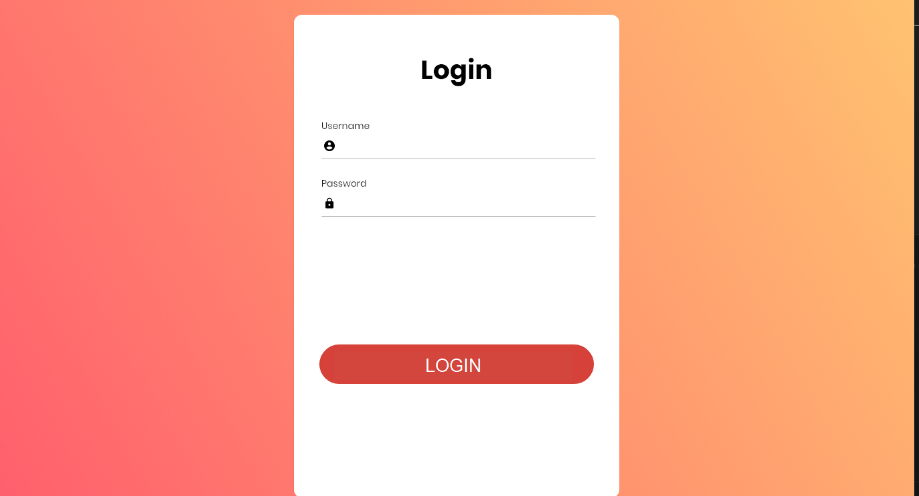
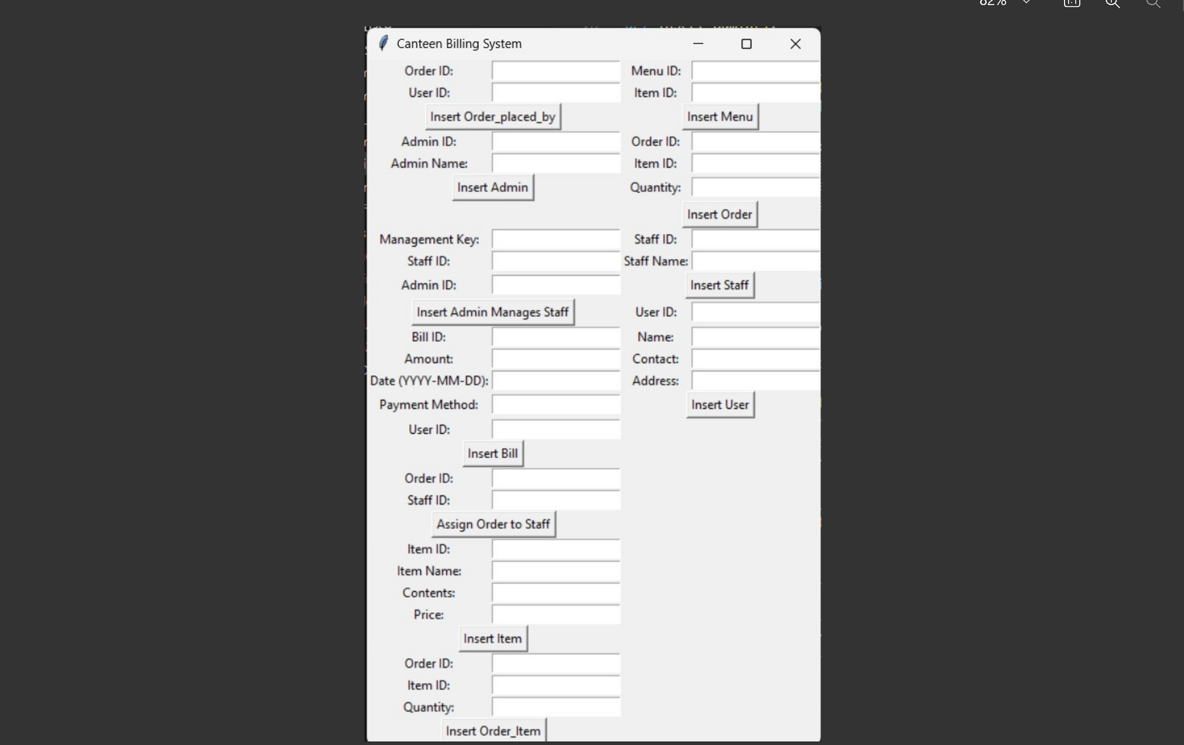

Visualisation :

Slide 18

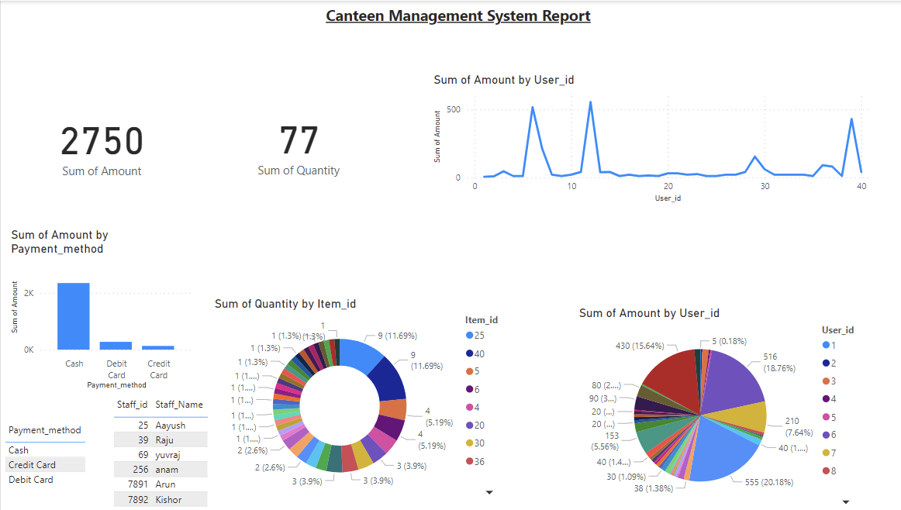

Report Generation:

Slide 19
Thank You

